Slide 1
Natural language to SPARQL
IMPRINT 2 KNOWLEDGE GRAPH
04-06-2020
Qumar Ibrahim

Slide 2
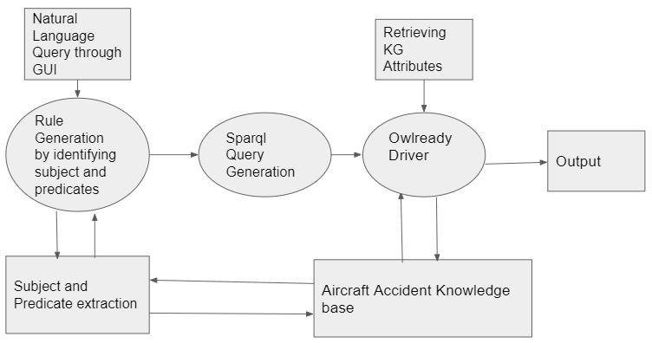
GUI Architecture

Slide 3
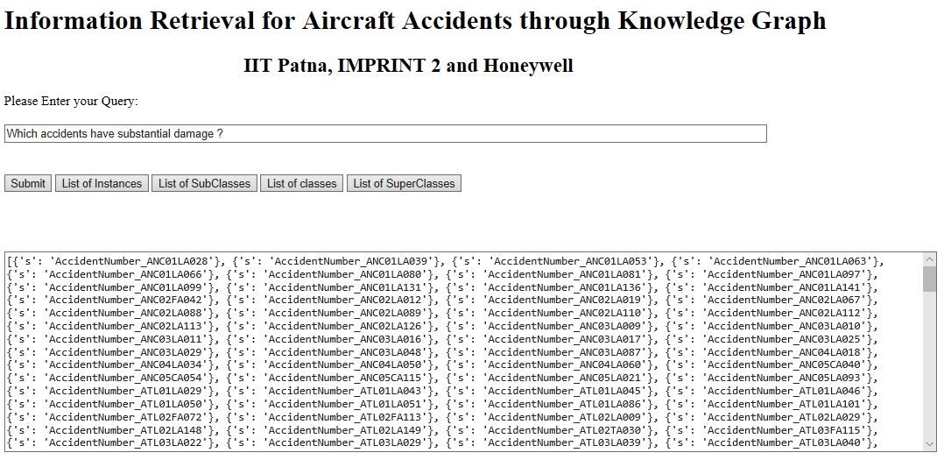

Slide 4
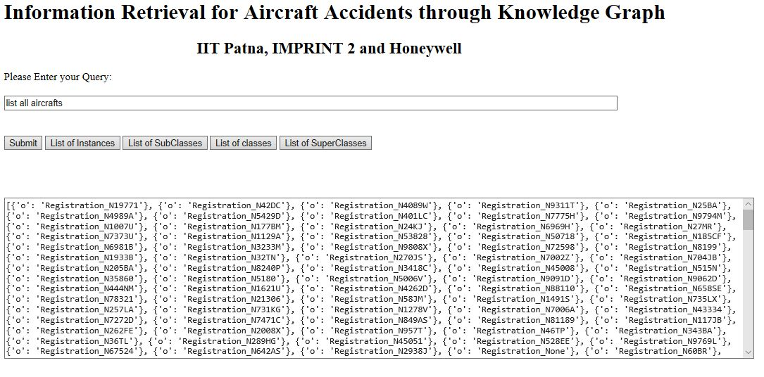

Slide 5
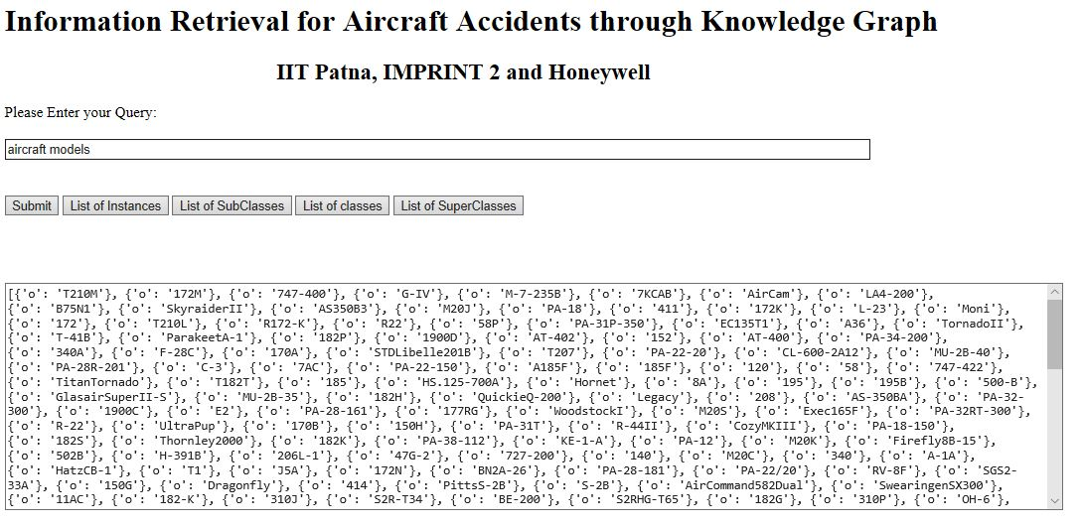

Slide 6
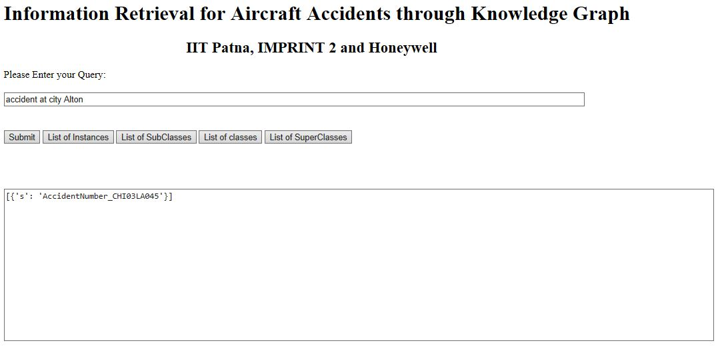

Slide 7
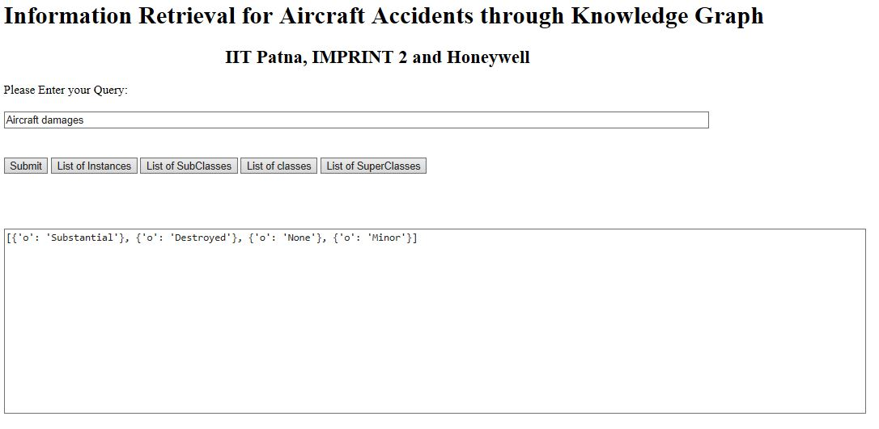

Slide 8
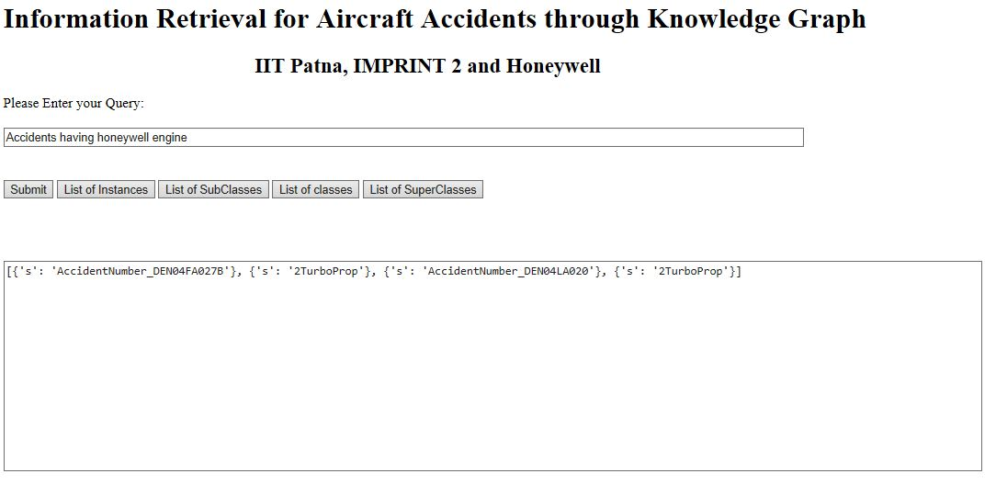

Slide 9
Working Algorithm
If Yes,
Search for predicates & classes
Search instances in NLQ usingKB, also identify Target Entity
If No, then by using dependency rules extract the related predicates from KB
Match the extracted class with target entity
Based upon the matched classes substitute the triples into appropriate class

Slide 10
Reference Papers
Peter Ochieng, PAROT: Translating natural language to SPARQL, Expert Systems with Applications: X, Volume 5, 2020, 100024, ISSN 2590-1885, https://doi.org/10.1016/j.eswax.2020.100024. (http://www.sciencedirect.com/science/article/pii/S2590188520300032)

Slide 11
THANK YOU

